Slide 1
CodeContracts and ReviewBot
Francesco Logozzo
Scott Carr, Shuvendu Lahiri & friends
MSR

Slide 2
1. Experience

Slide 3
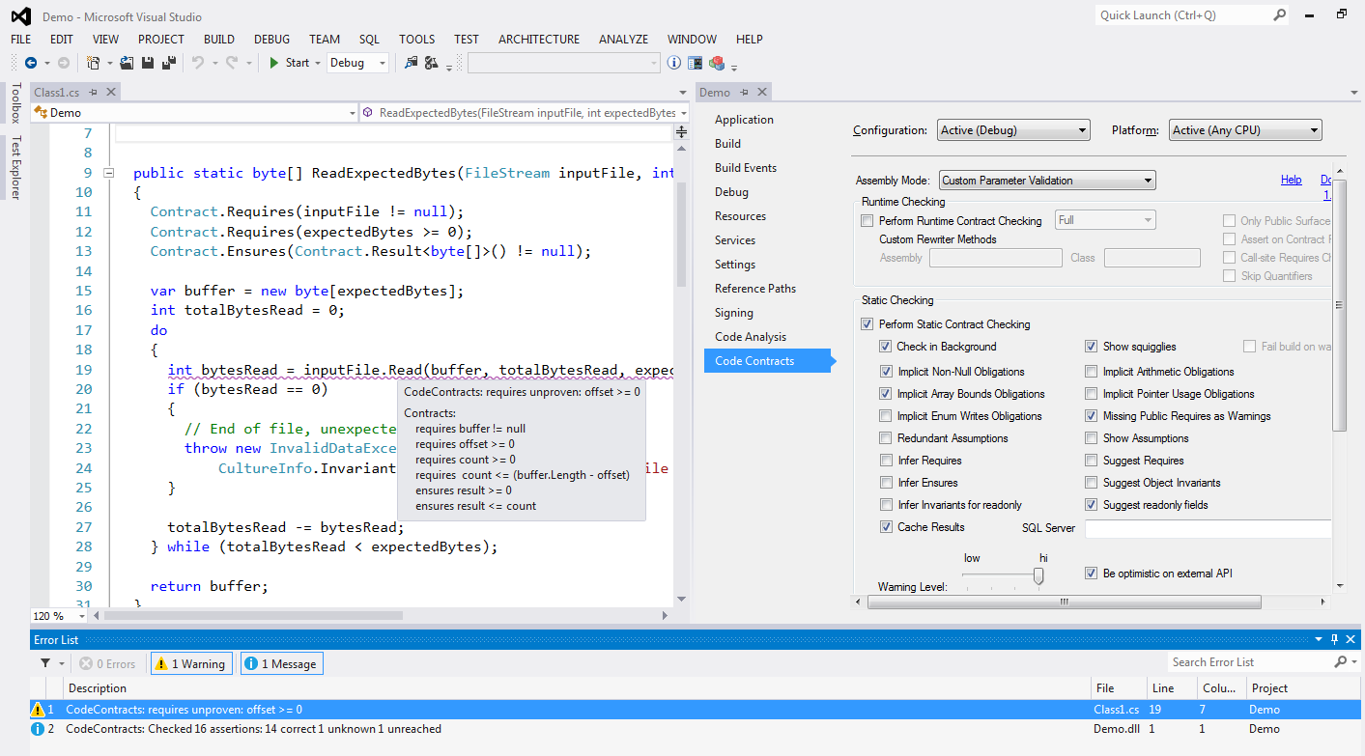
CodeContracts in
.NET 4.0
VS Integration
Failed precondition
Used in Domino!
(and many others)
Compile-time verification

Slide 4
Main issues with static analysis
Performance
Deep-semantic analysis is expensive
Too many alarms
Too much is unknown
Too many annotations
To reduce the alarms…

Slide 5
Addressing performance issues in CC
Adopt a method-level cache algorithm
Compute a semantic hash of the method
Hash everything that influences the analysis result
Do hash: CFG, Contracts, type hierarchy …
Do not hash: assembly GUID …
Cache stored locally or in a shared database
Use SQL just for convenience
Performance gain
> 10x

Slide 6
Addressing warnings in CC
Problem Analysis of program P produces a long set of alarms
Missing annotations on external APIs, handling of the environment …
Standard solutions
Baseline to only focus on new alarms
FxCop’s SuppressMessage, etc.
Add annotations to reduce false positives
Code Contracts, SAL annotations, etc.

Slide 7


Syntactic Baseline
Report the set of alarms Alarms(P’) \ Alarms(P)
Problem How do we match the same assertion in P and P’ ?
Syntactic matching inherently brittle and unsound
Mask new assertion
Baseline assertion
Resurrect masked assertion

Slide 8


VMV: Verification modulo versions
New!
P
Base version
P’
New version
Instrument
P’+C
Instrumented
Analyze
Analyze
Extract semantic conditions C
Reduce alarms
by > 80%

Slide 9
Example: Semantic alarm masking
Base version
New version
(correct)
Propagate backwards
/// Get temperature in Kelvin
double GetCurrTemperature()
{
var c = ReadTemperature();
Contract.Assume(c >= -273.15);
var round = Math.Round(c + 273.15, 2);
Contract.Assert(round >= 0);
return round;
}
(Silently) add assumption
/// Get temperature in Kelvin
double GetCurrTemperature()
{
// Temperature in Celsius
var c = ReadTemperature();
var k = c + 273.15;
Contract.Assert(k >= 0);
return k;
}
Infer
c ≥ -273.15
Prove assertion:
no warning!
Can’t prove assertion
ReadTemperature >= -273.15

Slide 10
Example: Regression
Base version
New version
(wrong)
/// Get temperature in Kelvin
double GetCurrTemperature()
{
var c = ReadTemperature();
Contract.Assume(c >= -273.15);
var k = c + 273.0;
Contract.Assert(k >= 0);
return k;
}
(Silently) add assumption
/// Get temperature in Kelvin
double GetCurrTemperature()
{
// In Celsius
var c = ReadTemperature();
var k = c + 273.15;
Contract.Assert(k >= 0);
return k;
}
Infer
c ≥ -273.15
New alarm:
Bug!!!
ReadTemperature >= -273.15

Slide 11
Addressing missing annotations in CC
Clousot can infer many contracts
But not all!
Use Roslyn to inject contracts
Attach contracts to the right places
Generate contracts even for interfaces!
Check well-formed, compiles …
ReviewBot: Automatically generate CodeFlow review
Use VMV to focus alarms on new errors/changes
Keep the codebase always fully annotated
Add thousands of Contracts with a click!!!

Slide 12
2. Requirements/next

Slide 13
What we need and we dream of…
The build system to call us with the assembly to analyze
Abstract from the build details
An API to abstract from storage (caching, VMV …)
Local, SQL, Azure tables, Azure SQL…
Tighter integration with the reviewing system
E.g., Accept/Reject proposed annotations, User-feedback on warnings …
A managed system to store and deliver contracts (both native and managed!)
“Which is the contract for this M?”
“Add this contract for N”
….

